Slide 1

Module 3: Intrusion Detection Systems
Prepared By:
Prof. Sridhar C Iyer
Assistant Professor
Dept. of Computer Engineering
Dwarkadas J Sanghvi College of Engineering

Slide 2

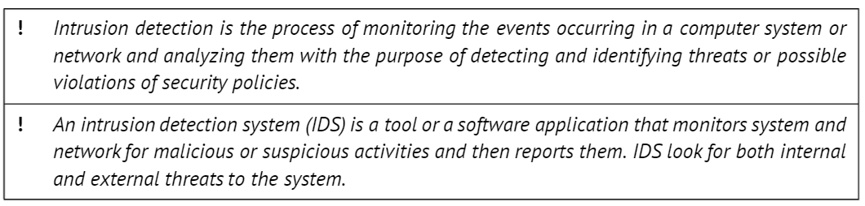
Definition

Slide 3
Definition
An intrusion detection system (IDS) attempts to monitor a system, a host, or a network in order to detect intrusions or malicious activities.
A malicious activity can occur due to an attack by outside influences such as malware and hackers getting unauthorized access.
However, it can also be caused by inside influences, like misuse of privileges, violations of company policies, etc.
An IDS is a system that automates the process of recognizing an ongoing attack or an imminent attack on the system or network it runs on.

Slide 4
Definition
These abnormal or malicious activities can be invoked by authorized or unauthorized users. An IDS has to determine which of these activities should be flagged, or in other words, an IDS aims at classifying all activities into normal and not normal with a possible identification of the abnormal ones.
To accomplish this goal, an IDS should implement certain analytical procedures. Using its classification methodology, IDS can analyze the activities and either flag or log the invalid actions as possible intrusions.
These invalid actions can then be passed to an intrusion prevention system (IPS), such as a firewall, or to a system administrator for further reviews and actions.

Slide 5
Goal
The IDS goal is to improve the security of computing systems by detecting the attacks or intrusions on the system. The intrusions may come in two types: internal or external.
An internal intrusion occurs when an authorized user with limited access rights tries to violate those access restrictions or to misuse the assigned authorization.
An external intrusion occurs when unauthorized user tries to gain an access.

Slide 6
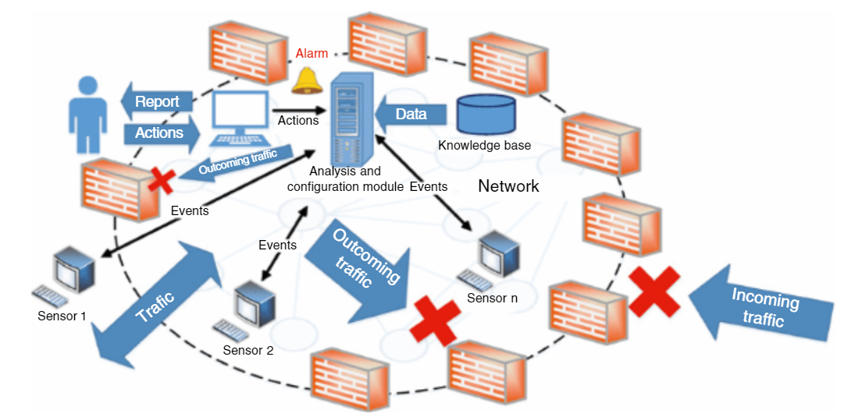
Goal
The figure below illustrates the IDS concept and its design as well as its relationship with the firewall protection.

Slide 7

Idea
The idea of intrusion detection was the first one that came into mind when researchers just started thinking about security and protection of computer and information systems.
Obviously, the first thing one has to do in order to protect computer and information systems is detecting intrusions or attacks. This is why historically, the IDS set up one of the first concepts that made a foundation for computer security and information assurance.

Slide 8
Idea
It provides an extra layer to ensure the protected infrastructure integrity, an ability to track a user's activity from the point they entered a system to the point of impact, a means to determine changes or modifications in data streams and files, and a possibility to detect errors in the system configuration.
Also, an IDS may facilitate data collection that could be employed to derive knowledge needed to analyze and improve system security, security policy, and the security administrator's guidelines.
However, in a general case, an IDS cannot compensate for weak network protocols, access control, or authentication systems. It is not able to block an attack or an attack source, to investigate independently an attack origin, or perform a detailed network analysis.

Slide 9
Idea
IDS are built to be in a continuous state of monitoring networks or end host systems and to be looking for specified patterns or anything that is out of the ordinary.
They scan through a network traffic or through running processes on an end user's machine to find anything that they should log as a security violation.
As all systems may have vulnerabilities, which attackers look for exploitation, it is the IDS role to detect such attempts and notify the responsible authorities to block them, prevent the future attempts, and possibly catch those responsible.

Slide 10
Attack Methodology
Attacks can come in various types and shapes and represent different cases, such as malware, spyware, unauthorized system access, authorized users trying to elevate their system privileges, etc.
To assess what qualifies as an incident, an IDS should work as a classifier. To design a classifier, one may employ various techniques, including conventional search algorithms, artificial intelligence (AI), and machine learning (ML) methods.
Attacks, and especially smart and dangerous ones, are conducted over periods of time that might last pretty long and even overlap with previous attacks.

Slide 11
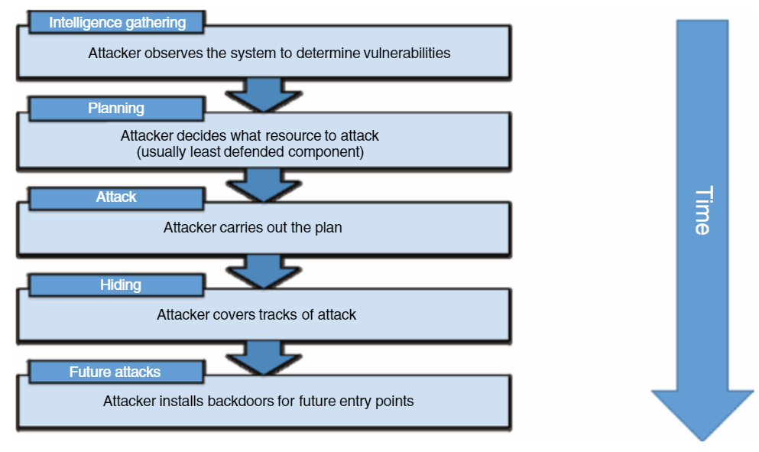
Attack Methodology
The typical intrusion process is presented as follows:

Slide 12
Why to deploy an IDS?
An IDS employment commonly provides a wide range of advantages:
1) IDS tools help organizations identify security problems or vulnerabilities, which can be exploited by attackers. Organizations can take corrective actions to improve system security by removing the perceived vulnerabilities in the system.
2) Threats logging creates a repository of information that organization security specialists can avail of when trying to create a security policy. IDS tools may provide great insight into the nature of the attacks that an organization faces that helps create a more specialized and effective security policy.

Slide 13
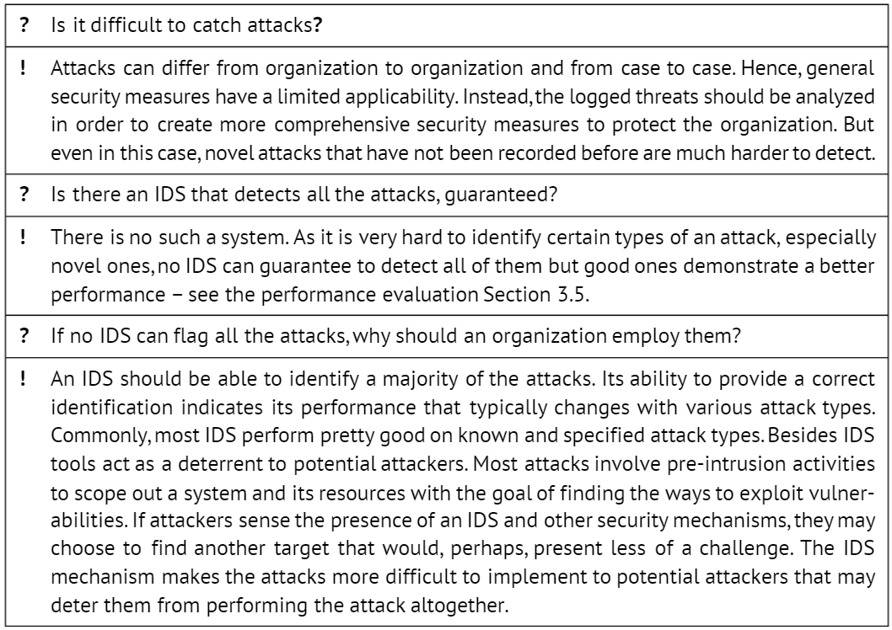
Some Shortcomings

Slide 14
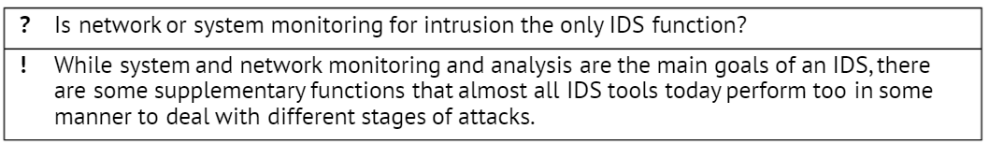
Functions of an IDS
Attack detection is a multitask problem and involves the following tasks ranging from design to execution and to analysis:
1) Data acquisition/collection
2) Data preprocessing and feature selection
3) Model selection for data analysis
4) Classification and result analysis
5) Sending an alarm in a case of a positive intrusion identification

Slide 15
Functions of an IDS
Additional functions may include:
Reconnaissance activities - IDS tools scan the system to detect pre-intrusion activities that help them identify the potential threats to the system and help system security administrators to take preemptive actions to block all imminent attacks.
Enforcing security policy - IDS tools provide the means to enforce an organization security policy by providing the rule set configurations, similar to ones that firewalls have, to detect traffic that may not qualify as an attack but may violate an organization-specific security policy. They aim at detecting all internal system activities, which may look to circumvent certain security policies. For example, a file transfer, which may be suspicious, attempts from internal users to log into systems to which they do not have access, copying large databases to an end user's laptops, etc.

Slide 16
Functions of an IDS
Additional functions may include:
Logging - This involves recording all security and suspicious incidents for future analysis. In many cases, all logged information is sent to central security management logging services for future referrals.
Alerts - This is a common task performed by almost all modern IDS tools. Notifying security administrators can be performed in multiple ways. Emails, pages, and simple messages service are just some of the ways in which alerts are performed. Alerts will generally give basic information about the nature of the attack. Security officials will often have to refer to the IDS logs for further information.
Report generation - This capability is also pretty common in most modern IDS tools. Monitoring events and summing up the contents of the logged incidents is an important task that is undertaken by IDS tools. The vast amount of information makes aggregating it and pro- viding reports to the security administrators, who should take corrective actions, quite essential.

Slide 17
IDS – From a Historical Perspective
We can see that an IDS category is very diverse now and can cater to different sizes of organizations with varied needs. In this section, we will take a look at how IDS has evolved over the years and what kind of systems can be developed in the future.
Conceptualization and Early Years (1980-Mid-1990s)
Commercialization of IDS (Mid-1990s-2005)
Proliferation of IDS and IPS (2006-2015)
AI and ML in IDS Design (2016- Present)

Slide 18
Conceptualization and Early Years (1980-Mid-1990’s)
The IDS was conceptualized in the early 1980 in a paper written by James Anderson, who provided a set of tools to system administrators to review access and event logs, by which they could determine the presence of an intruder in their system.
The seminal paper (Anderson 1980) helped define some of the terminologies, which are still in use, such as threat, vulnerability, penetration, masquerader, etc.
The paper also provided ways of characterization of a computer user and the structure of a surveillance system - how to monitor user behaviors, recording and sorting audit logs, and monitoring files.
The idea that audit logs contain information that can be important to track misuse and intrusion in a system was introduced by this paper too.

Slide 19
Commercialization of IDS (Mid-1990s-2005)
Haystack Labs introduced the first commercial product, Stalker, in the early 1990’s, marking the beginning of a variety of commercial IDS.
During the same period, Computer Misuse Detection System (CMDS), which was an HIDS was also developed.
The US Air Force developed Automated Security Management System (ASIM), which was a scalable and portable network intrusion detection system (NIDS). Their product was succeeded by NetRanger, which was the first commercially available NIDS.
This period saw the development of commercially available products from some big companies like Symantec, Cisco, ISS, and many more, making the IDS products more profitable year by year. Before the development of IDS, the market was dominated by firewalls.

Slide 20
Commercialization of IDS (Mid-1990s-2005)
Firewalls were available commercially from the early 1980s. The first generation of firewalls, also called the packet filters, mainly monitored a network and checked the IP, ports, and protocols used. They could filter packets based on some predefined rules and could not store any stateful information about the network.
These firewalls were used till the early 1990s. In 1989, the next generation of firewalls, called stateful inspection filters, were developed. They could do what packet filters did, but could also retain information about the connection, and they could then block traffic based on more complicated rules and not just on ports, IPs, and protocols.
The third generation of firewalls were developed in the mid-1990s, which could retain state information, and could monitor and understand certain application layer protocols; thus, they were known as application layer firewalls. Since the firewalls before 2000 were simple, they could process network traffic quickly, making them very effective for the time. Firewalls were the go-to tool to counter against security threats.

Slide 21
Commercialization of IDS (Mid-1990s-2005)
New kinds of attacks came along in the 2000s, like SQL Injection, which could use legitimate IPs, ports, and protocols, that made firewalls useless against those attacks. To protect an organization from these novel attacks, security professionals started using IDS alongside a firewall, where an IDS could detect an intrusion and sound an alarm to let system administrators know about the intrusion.
Another interesting development taking place during the same time period was an introduction of IPS, which could sit inline at the perimeter of the network, and has the ability to block any incoming traffic that it categorizes as malicious. It could also alert a system administrator, just like an IDS, who could handle it manually.
IDS vendors saw commercial success during this time period. But since most commercial IDS were signature based, they had to write signatures for every exploit that they could find. Now, a vulnerability in a piece of software can have many exploits, so once a vulnerability was detected by cyber criminals, they could exploit the vulnerability in many different ways.

Slide 22
Proliferation of IDS and IPS (2006-2015)
Security vendors started adopting an IDS/IPS from around 2005. By that time, the IPS component also got faster, providing protection from threats up to a throughput of 5 Gbps, thus capable to service bigger organizations with the necessary bandwidth to monitor their much bigger network infrastructure.
Today, most IPS can provide security at around 50 Gbps of network traffic. These improvements saw bigger clients switch from IDS to IPS mode. Also, attackers continuously keep changing the threat landscape by trying new ways to enter a system. This led to a faster development and integration of different techniques being employed by IDS/IPS vendors for their product.

Slide 23
Proliferation of IDS and IPS (2006-2015)
To provide additional countermeasure against newer attacks, they added features to block malicious commands, IP addresses that were known to host malware, in addition to already employed techniques like pattern matching, anomaly detection, and heuristic-based detection.
The next generation of IPS was getting developed as more and more organizations had intrusion detection and prevention systems (IDPS), a combination of both IDS and IPS, installed. Attackers also started developing their techniques, and attacks became more sophisticated with deep understanding of the networks.
The next generation intrusion prevention system (NGIPS) could do everything a normal IDPS system could do, and much more. It added such important features as an application control, where a user was limited to only a certain specific set of features of an application, depending on which network the user is on, and the user's location.

Slide 24
AI and ML in IDS Design (2016- Present)
Intrusion detection importance and sophistication grows up with time. As more and more data resides online now, the need for an efficient and effective IDS/IPS has a paramount value.
Artificial intelligence (AI) methods for classification may help to detect and learn complex patterns in net- work and audit data. This results in better classification as simple methods like string matching, which used to work quite well in the past, cannot be relied upon when the attack landscape has changed significantly, with attackers using novel techniques.
However, since the volume of data generated has increased exponentially over the last decade, IDS must process data faster. If a real-time detection is desired, some form of data reduction also has to be done before the actual analysis.

Slide 25
AI and ML in IDS Design (2016- Present)
The proliferation in IoT technology resulted in generation of a lot of data. In the coming decade, the number of such devices is likely to increase exponentially that will build a lot of pressure on IDS/IPS. Vendors are more likely to use fast AI classification models for both detection and prevention. Moreover, the focus will shift more toward preventing an attack, rather than detection.
Other prominent current trends in IDS design and development present further integration of IDS with firewall and other protection services, merging various parts and approaches in IDS design as well as globalization in IDS deployment and data used.

Slide 26
Typical IDS Architecture Topologies
Based on their operational range, IDS architectures are commonly classified into the following categories:
Host Based IDS (HIDS)
Network Based IDS (NIDS)
Wireless IDS (WIDS)
Network Behavior Analysis System NBA)

Slide 27
Host-based Intrusion Detection System (HIDS)
HIDS are deployed on a specific host, monitor it, and gather information on that host, usually by putting it into log files. These systems gather information regarding network traffic, processes and programs running, and other data that could help decide if there is any intrusion or malicious use attempt.
HIDS can be more efficient in determining if an intrusion has been successful but can be costly to deploy and maintain on every host. The HIDS takes a snapshot of your existing system files and matches it to the previous snapshot. In a case when the critical system files were altered or deleted, the alert is sent to the system administrator for further investigation.

Slide 28
Host-based Intrusion Detection System (HIDS)
HIDS are mostly set up on critical system servers that are not expected to change frequently. An HIDS aims at identifying an unauthorized, illicit, and anomalous behavior on a specific device. It generally involves an agent installed on each system, monitoring and alerting operations on local operating system and application activity.
The installed agent uses a combination of rules, heuristics, and signatures to identify an unauthorized activity. The role of an HIDS is also passive, only gathering, identifying, logging, and alerting.
Examples of HIDS implementation tools are Open Source Host-based Intrusion Detection System (OSSEC), Tripwire, and Advanced Intrusion Detection Environment (AIDE).

Slide 29
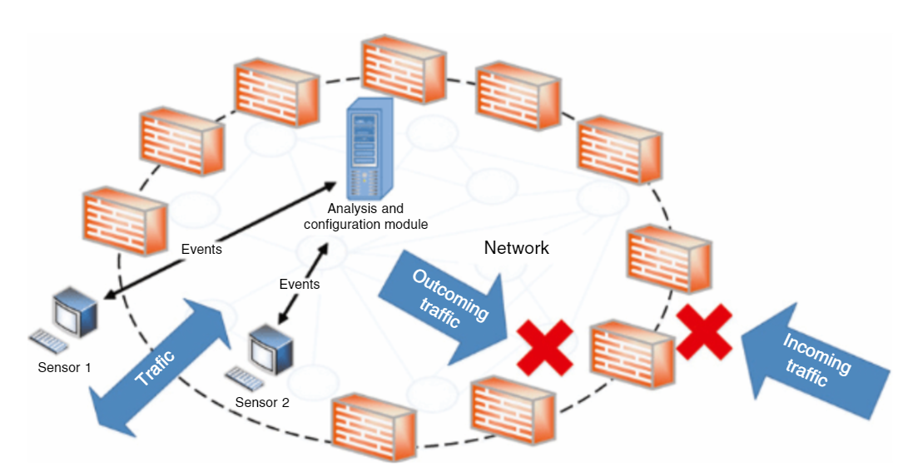
Host-based Intrusion Detection System (HIDS)

Slide 30
Host-based Intrusion Detection System (HIDS)
HIDS also have some limitations. The detection techniques are not performed all the time, so malicious activities may happen between the working periods that may result in delay in their detection. Agents are installed on every client as well as servers, these agents utilize some of the resources of their hosts, that also results in performance degradation of hosts.
Moreover, installing such agents on hosts may also result in conflicts with existing security appliances such as firewalls or VPN clients.
The major disadvantages of HIDS may be based on the following features:
If there are more than one server in a network, HIDS cannot detect any intrusions coming from another network part.
HIDS maintenance could grow up into an administrator's nightmare if there are a lot of systems with different configurations and different environments.

Slide 31
Network-based Intrusion Detection System (NIDS)
Network Intrusion Detection system (NIDS) focuses on the network attacks. NIDS attempt to identify unauthorized, illicit, and anomalous behavior based solely on network traffic patterns, using a network tap, span port, or hub collecting packets that traverse a given network.
Using the data captured, the IDS processes and flags any suspicious traffic. The role of an NIDS is passive as it only gathers information, identifies intrusions, logs data, and sends alerts but has no capabilities to block or stop attacks. For example, the system monitoring the subnet, where the firewalls are located, to see if someone is trying to get through, is a typical application of NIDS.

Slide 32
Network-based Intrusion Detection System (NIDS)
Network-based IDS are usually built only for particular network segments and analyze the data related to this segment traffic for any unauthorized events. NIDS use sensors to monitor and analyze activities in a network segment. These sensors may be utilized in two modes.
In the first mode, they are employed as inline devices, through which an actual traffic goes.
In the second mode, passive sensors are used so that an actual copy of traffic is analyzed. Inline sensors are mainly used in network IPS, whereas passive sensors are used in IDS.

Slide 33
Network-based Intrusion Detection System (NIDS)
Network-based IDS use multiple security appliances. One of the important tasks performed by NIDS is to maintain the log of detected network traffic data or any detected suspicious activity.
They also perform the packet captures. Nowadays, NIDS have become more and more complex and integrate various types and operational modes. Organizations use NIDS, which may combine anomaly based detection, stateful protocol analysis, signature-based detection, as such integration increases the accuracy of detection.

Slide 34
Network-based Intrusion Detection System (NIDS)
We can classify the NIDS design according to the system interactivity property. There are two kinds of NIDS:
Online NIDS - Online NIDS commonly deal with the network data in real time by conducting an immediate traffic analysis and making a decision on the attack detection and identification.
Offline NIDS - Offline NIDS take the data that was previously logged, stored, and then passed to it for an attack identification.

Slide 35
Network-based Intrusion Detection System (NIDS)
There are few limitations to the network-based IDS, such as inability to detect encrypted information. In such cases, they should be used before information is encrypted or after it is decrypted.
When there exists a high traffic load on the network, the network-based IDS may fail to perform the full analysis. Also, in this case network-based IDS are not capable of detecting different types of attack, such as DDoS or working with different device versions.
When analysis needs to be performed on traffic between various types of servers, which may have different types of configuration and communication characteristics, the accuracy of detection may drop down.

Slide 36
Wireless Intrusion Detection System
Wireless Intrusion Detection System (WIDS) examines the wireless network traffic for any suspicious activity on the network. In addition, they analyze the wireless networking protocols. Wireless IDS can investigate only one channel at a time, hence they perform sampling of traffic, whereas network-based IDS analyze packets in segments.
As wireless IDS perform detection channel by channel, there exists a big possibility of error or bypassing any malicious activity. In order to avoid such errors, sensors usually work in parallel with many channels, monitoring each channel for some amount of time and then shifting to another channel. Sensors employed in wireless IDS could be classified into dedicated sensors and bundled sensors.
Unlike bundled ones, dedicated sensors are not capable to pass data from a source to a destination but typically provide stronger detection capabilities. Dedicated sensors are typically costlier than bundled.

Slide 37
Wireless Intrusion Detection System
Wireless IDS also perform the task of logging the information about the detected activity and can monitor different types of attacks related to wireless protocols. Using a combination of different detection systems, an organization can improve a detection capability of wireless IDS, for example by use of triangulation, which has a capability to detect a physical location of a threat.
Though wireless IDS commonly demonstrate good detection capabilities, limitations still exist. There are some kinds of activities, which typically cannot be detected by wireless IDS, such as attacks that require passive monitoring and offline processing, DDoS attacks, and some of the physical attacks. Even with these limitations, wireless IDS can also offer intrusion prevention capabilities; sensors in wireless IDS can send signal to end points or switches, which are located at the wired network; and these devices can block the suspicious activities.

Slide 38
Network Behavior Analysis (NBA) System
Network Behavior Analysis (NBA) System is an extension of network-based IDS that commonly has sensors and consoles, and possibly specialized servers called analyzers. They might have some of the sensors that are used in it, complemented with some additional sensors and consoles.
Sensors involved in NBA systems are similar to sensors in network-based IDS. Also, they typically inspect the packets from the one or more network segments, and other sensors inspect the network information gathered from the routers and other physical devices used in the network.
The main NBA goal is to improve the system analysis capabilities by increasing the amount of information to analyze. Commonly, NBA systems provide excellent detection capabilities, which include detection of attacks such as DoS, worms that spread quickly through the networks, scanning of anonymous data flow, and things that come under policy violations. They have a great feature of logging the data related to any unusual activities. Frequently, they may have the capabiliity to find origin of the threat by performing a series of observed events.

Slide 39
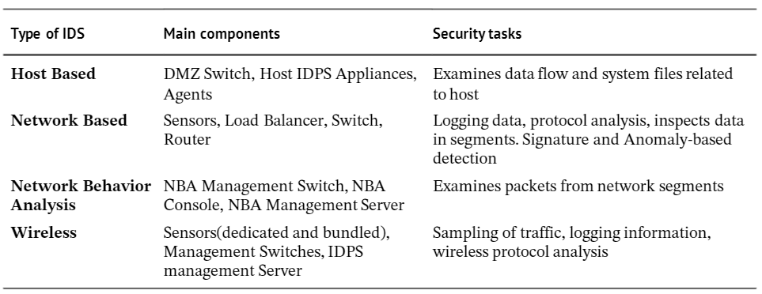
Comparative Summary
Features

Slide 40
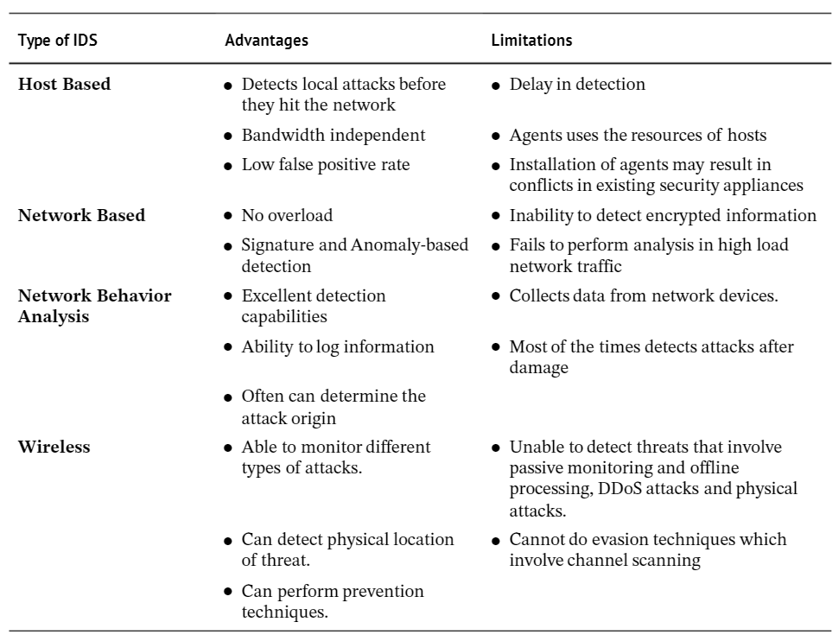
Comparative Summary
Configuration

Slide 41
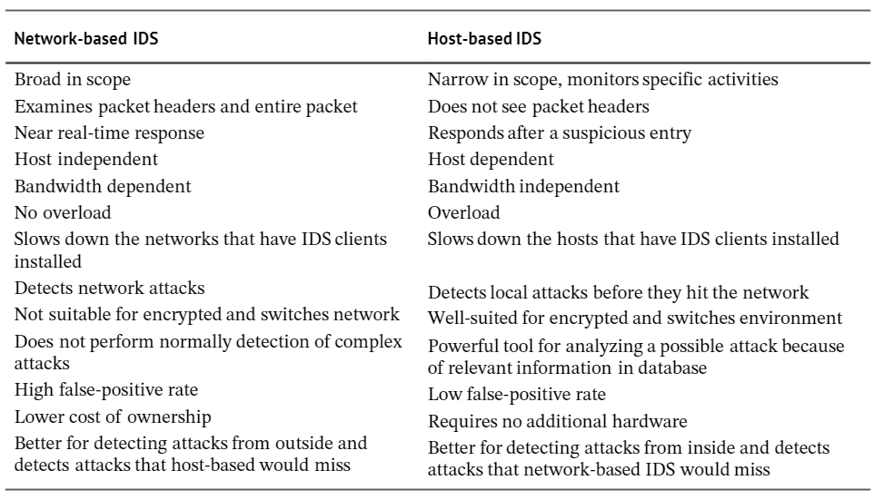
Comparative Summary
HIDS vs NIDS

